Slide 1
Accio: Variable-Amount, Optimized-Unlinkable and NIZK-Free Off-Chain Payments via Hubs 葛钟慧，顾家源，王晨珂，龙宇，徐贤，谷大武
CCS 2023
曹阳洲
2024.12.06

Slide 2
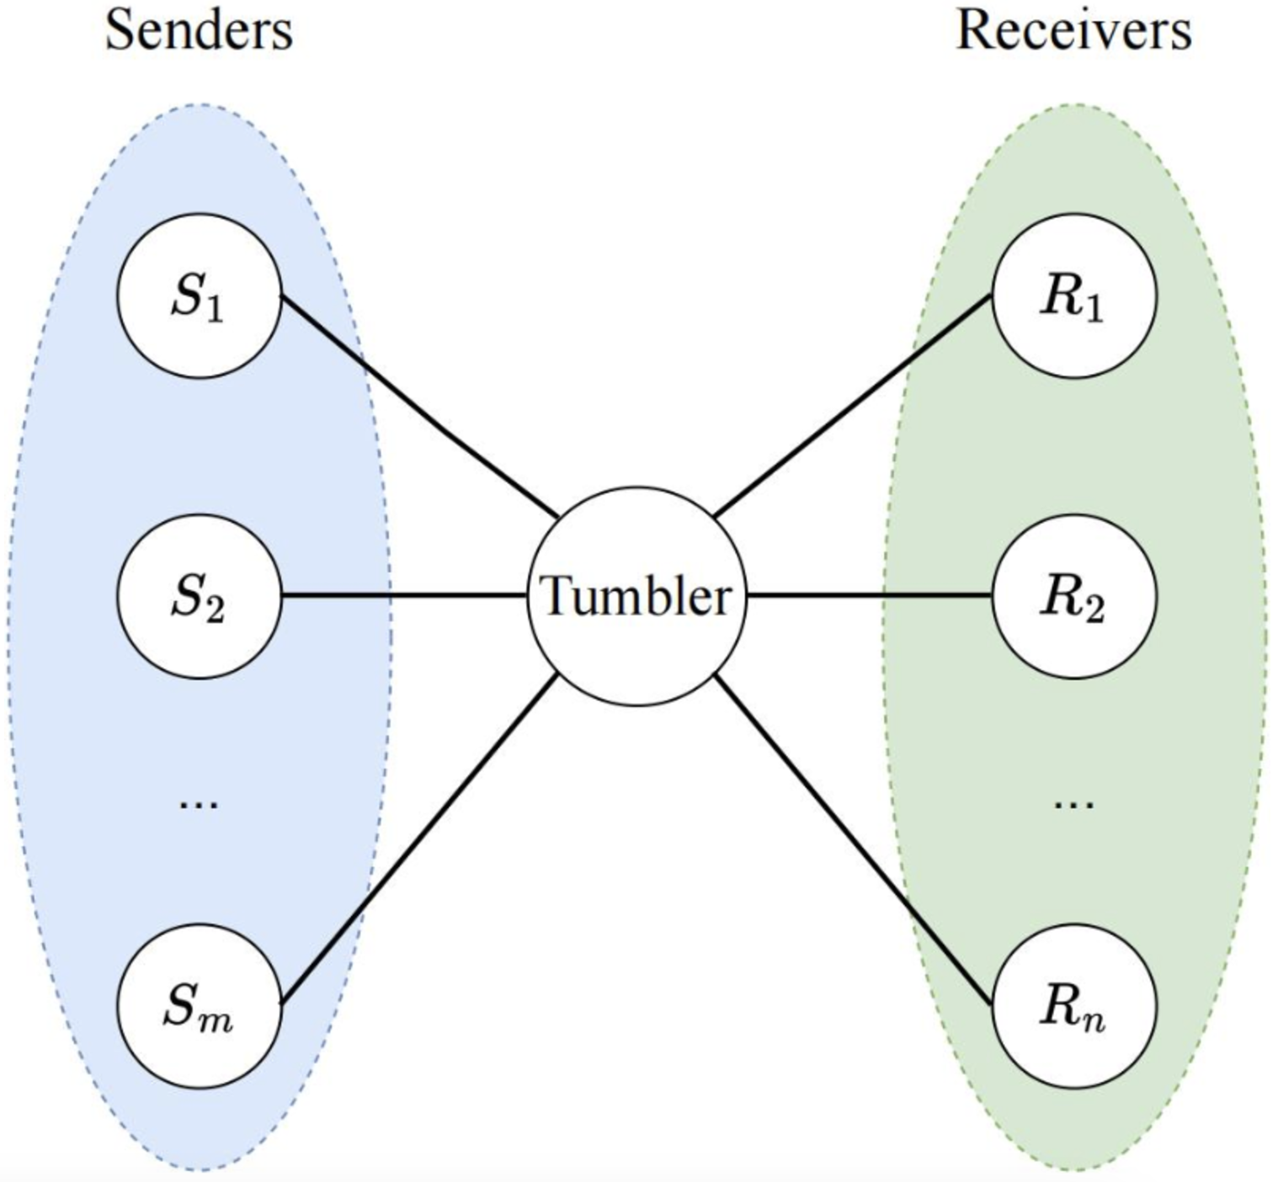
Payment Channel Hub
支付通道中心（PCH）是解决第一代区块链或比特币等加密货币的可扩展性问题的一个很有前途的解决方案。它支持通过中介（称为tumbler）在发送者和接收者之间的链下支付。关系匿名性和金额隐私是保护隐私的PCH的理想特征，它防止了中间人识别发送方和接收方，以及支付金额。
交易撤回？

Slide 3
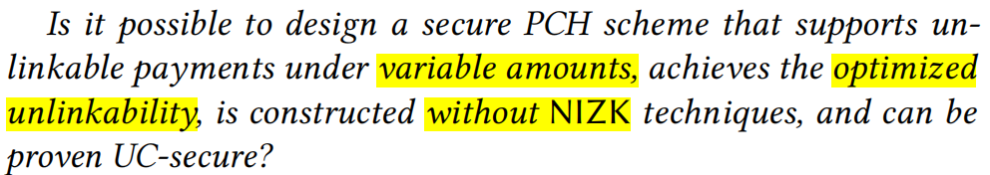
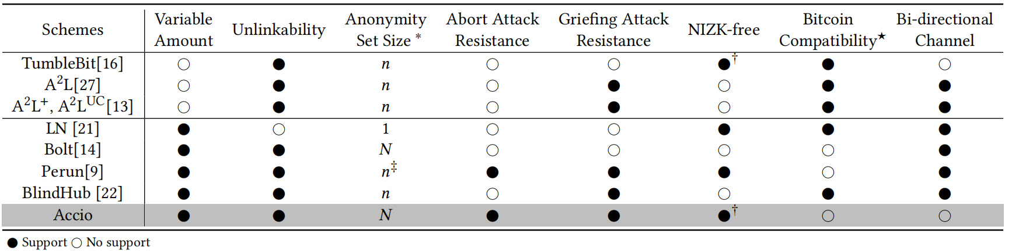
Comparison
不加ZK加其他组件达到双向通道？
Motivation

Slide 4
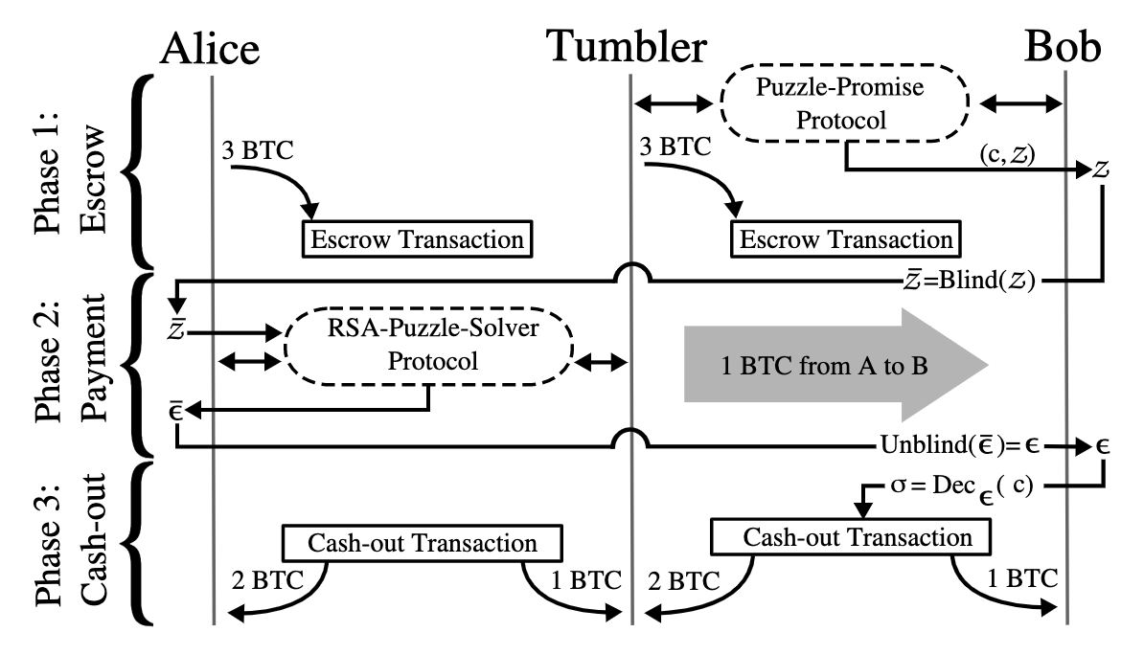
Puzzle-promising and Puzzle-solving paradigm
金额的>0范围证明？编码方式？同态方式？

Slide 5
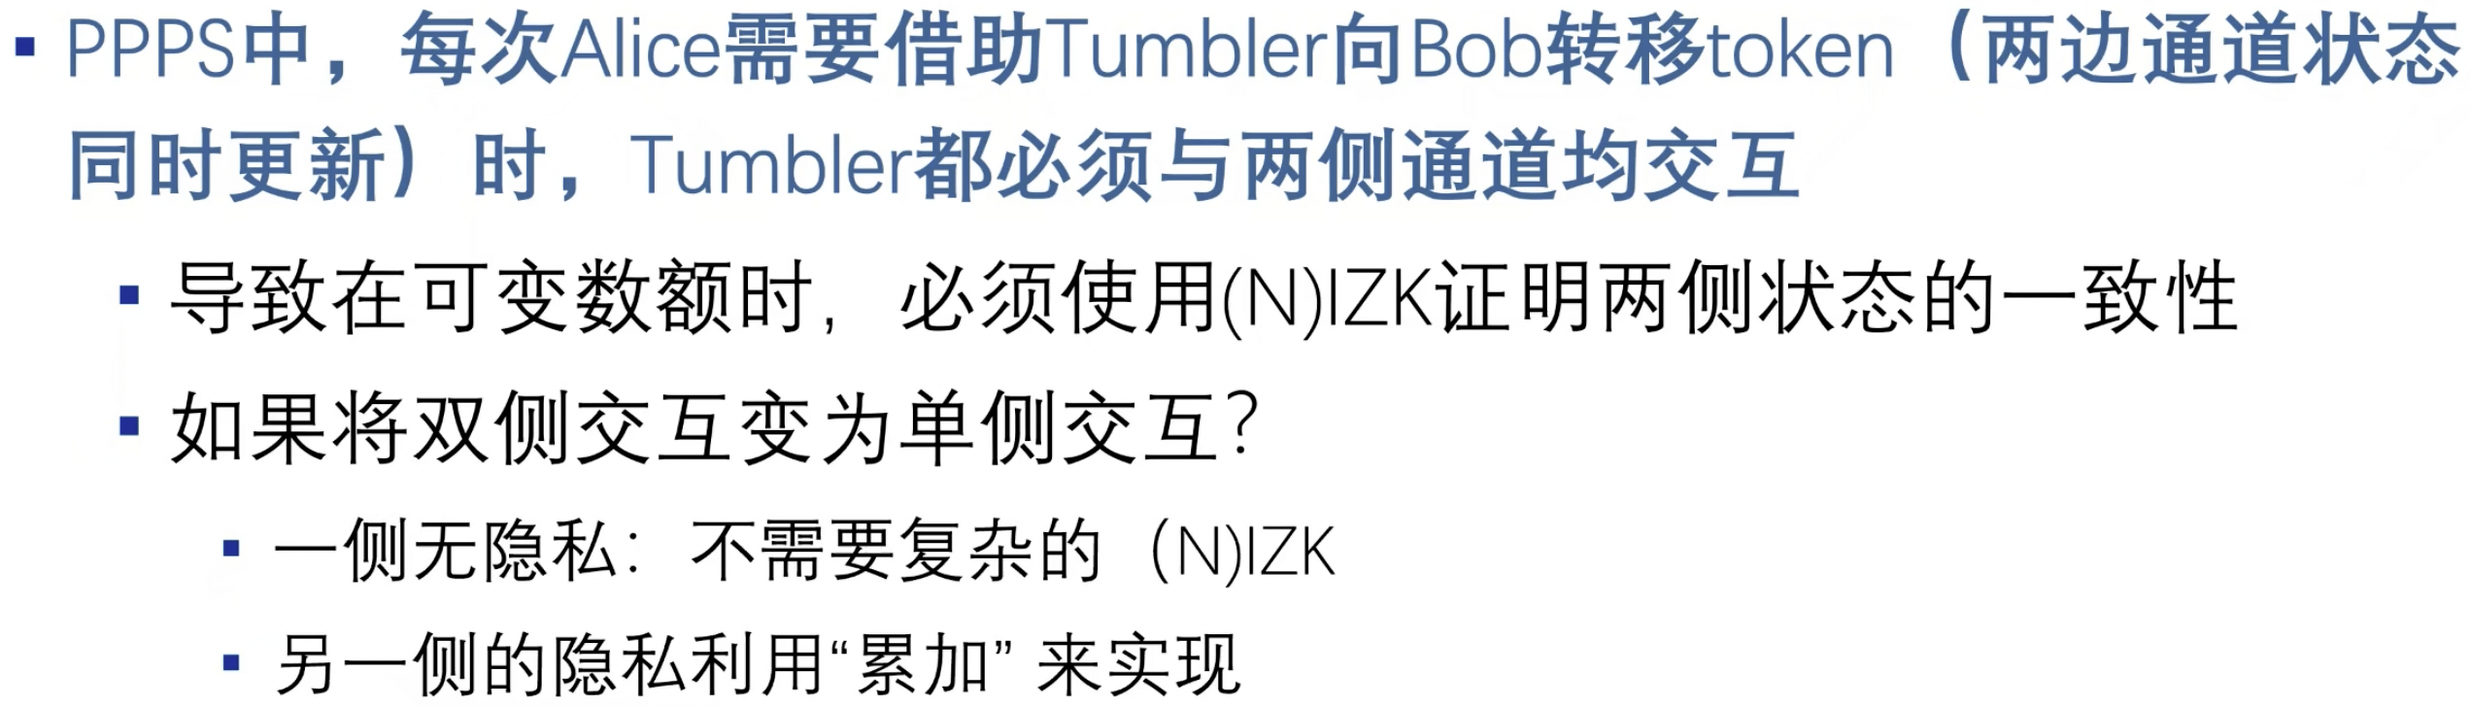
Puzzle-promising and Puzzle-solving paradigm

Slide 6
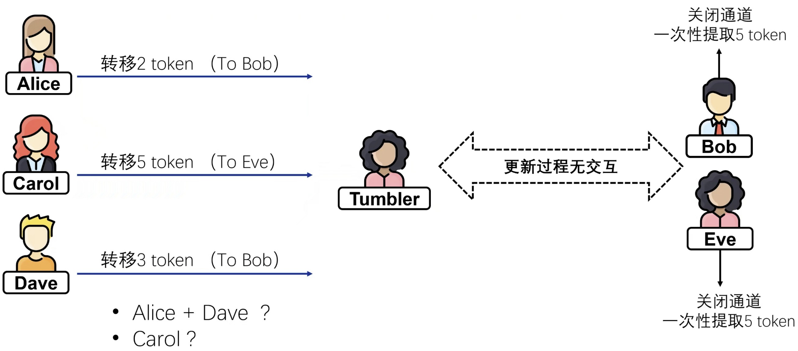
Replace Puzzle-promising and Puzzle-solving paradigm

Slide 7
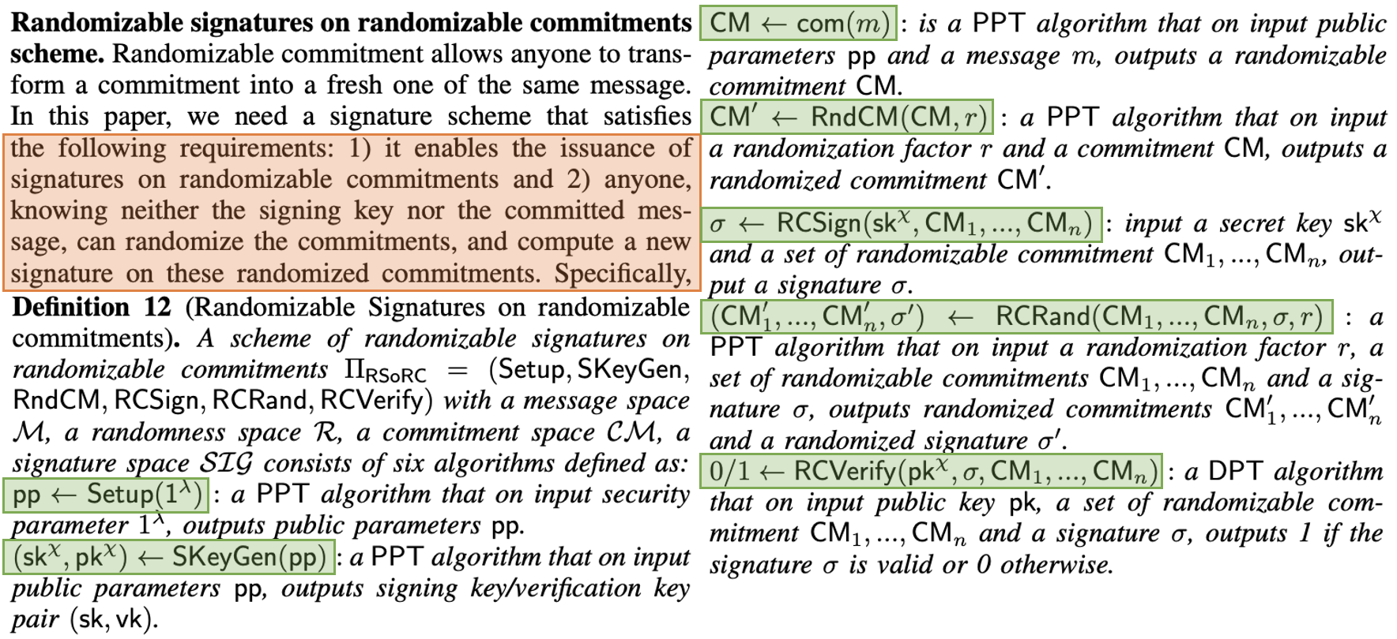
Randomizable Signatures on Randomizable Commitments
Old Definition

Slide 8
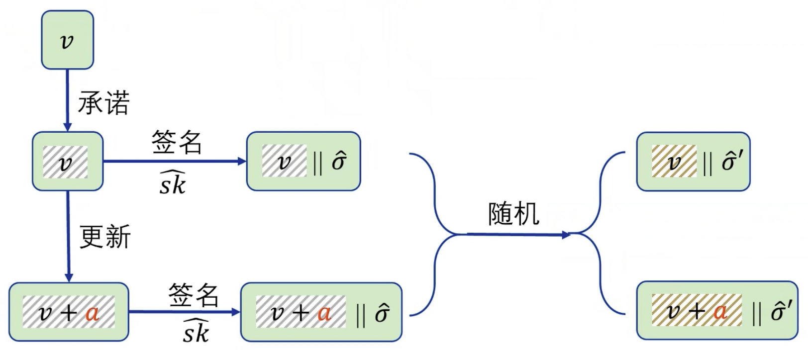
Randomizable Signatures on Randomizable Commitments
New Definition

Slide 9
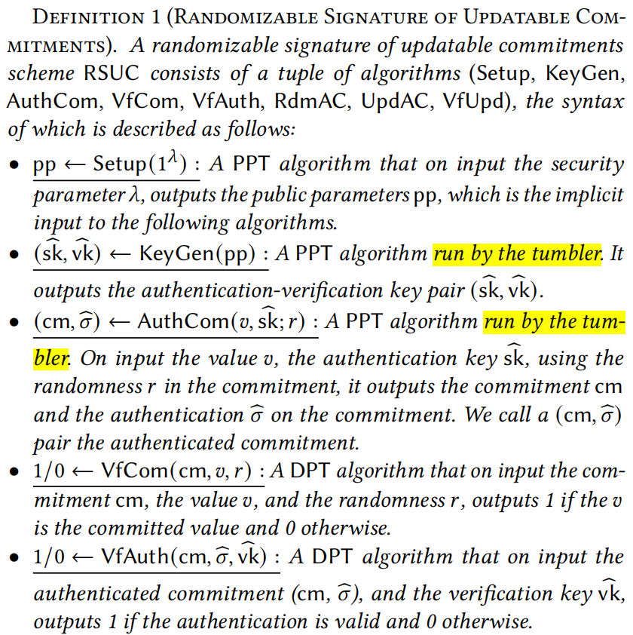
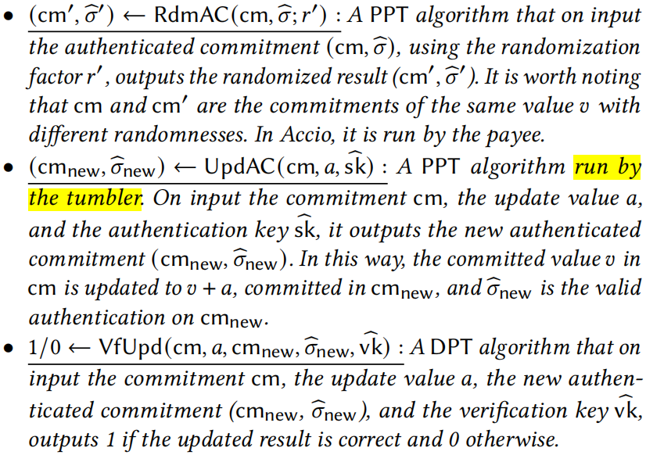
Randomizable Signatures on Randomizable Commitments
New Definition

Slide 10
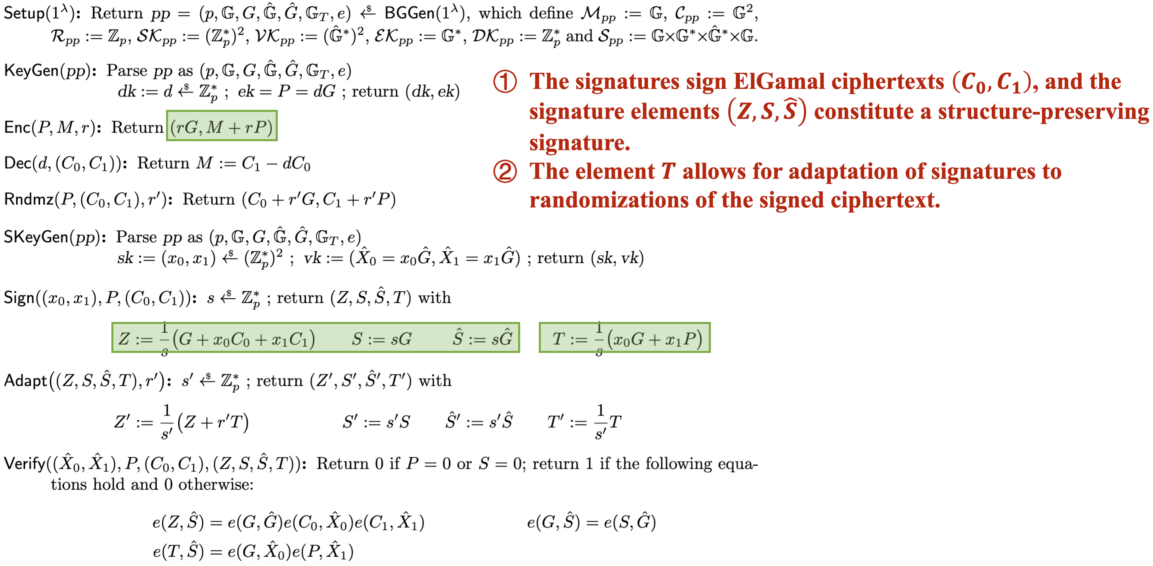
Randomizable Signatures on Randomizable Commitments
Old Scheme

Slide 11
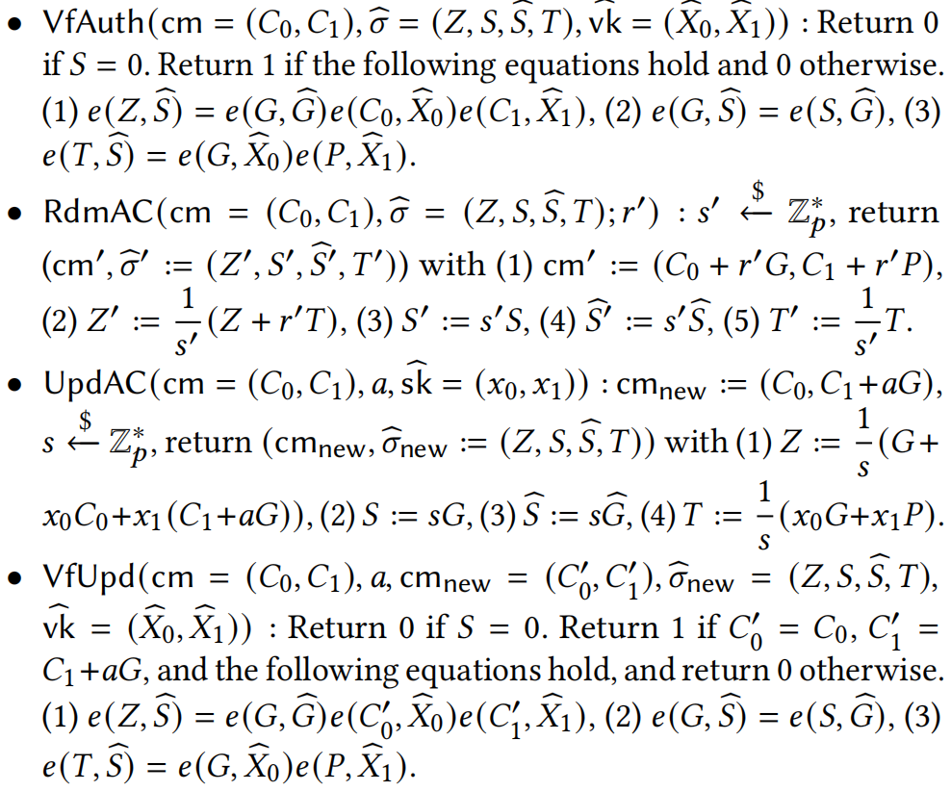
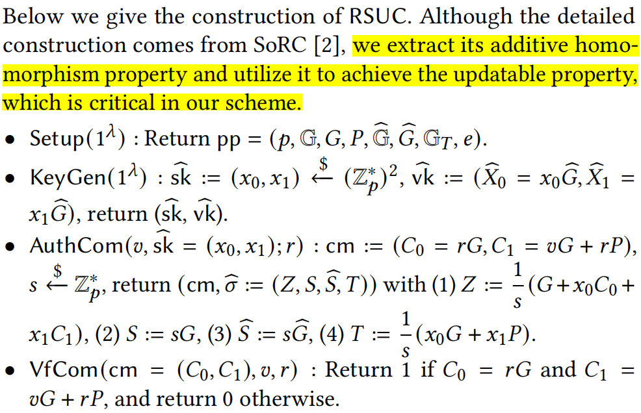
Randomizable Signatures on Randomizable Commitments
New Scheme

Slide 12
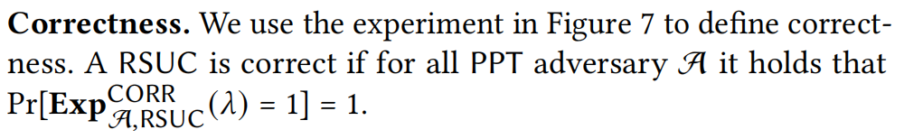
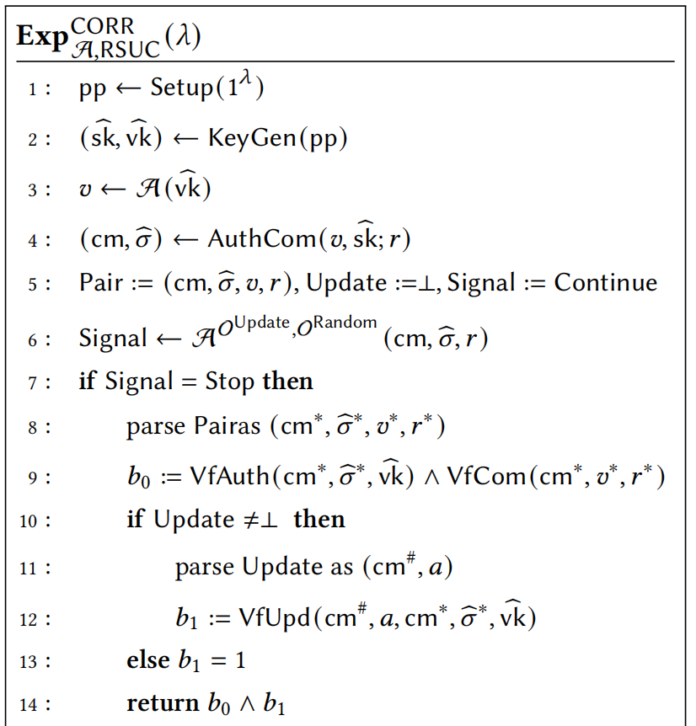
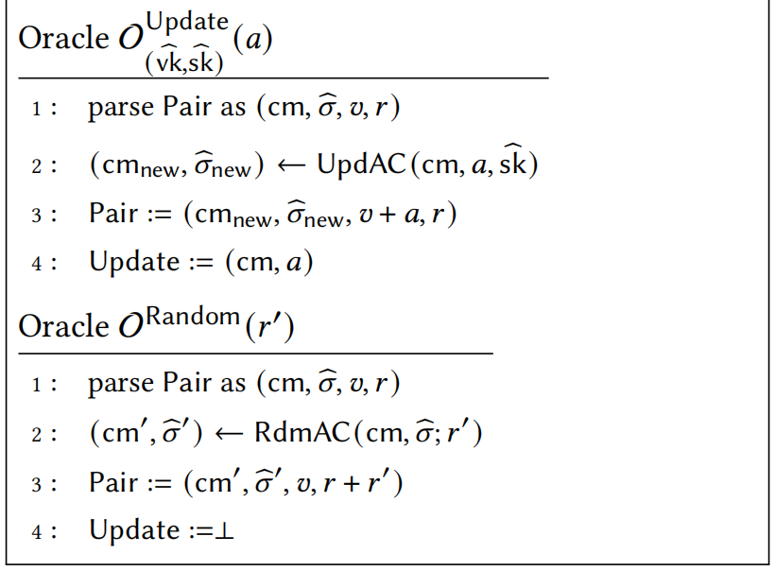
Randomizable Signatures on Randomizable Commitments
New Security Definition 1

Slide 13
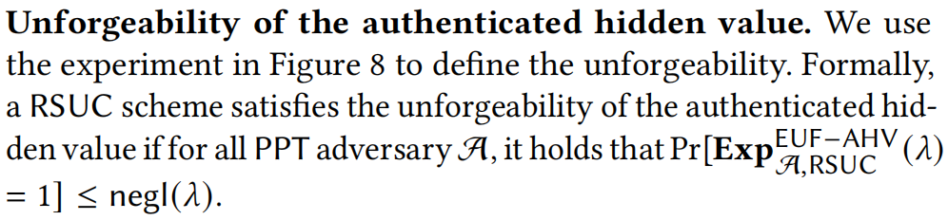
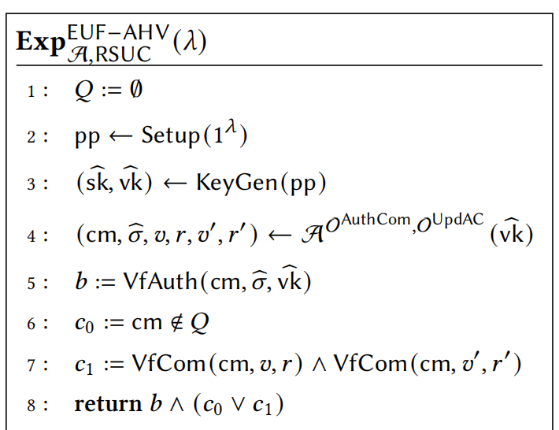
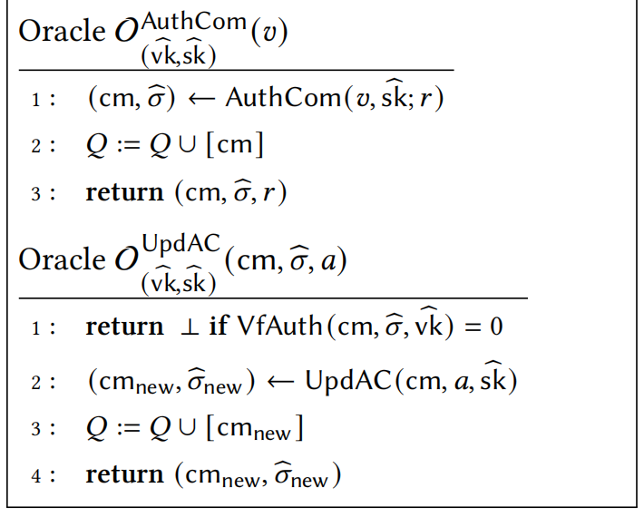
Randomizable Signatures on Randomizable Commitments
New Security Definition 2

Slide 14
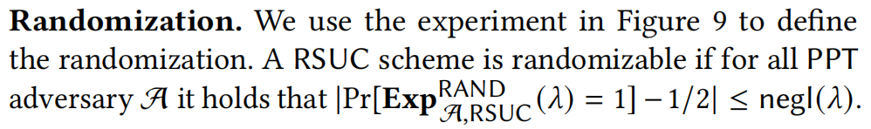
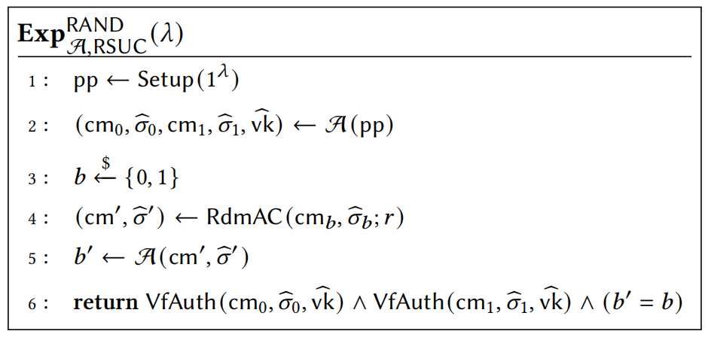
Randomizable Signatures on Randomizable Commitments
New Security Definition 3

Slide 15
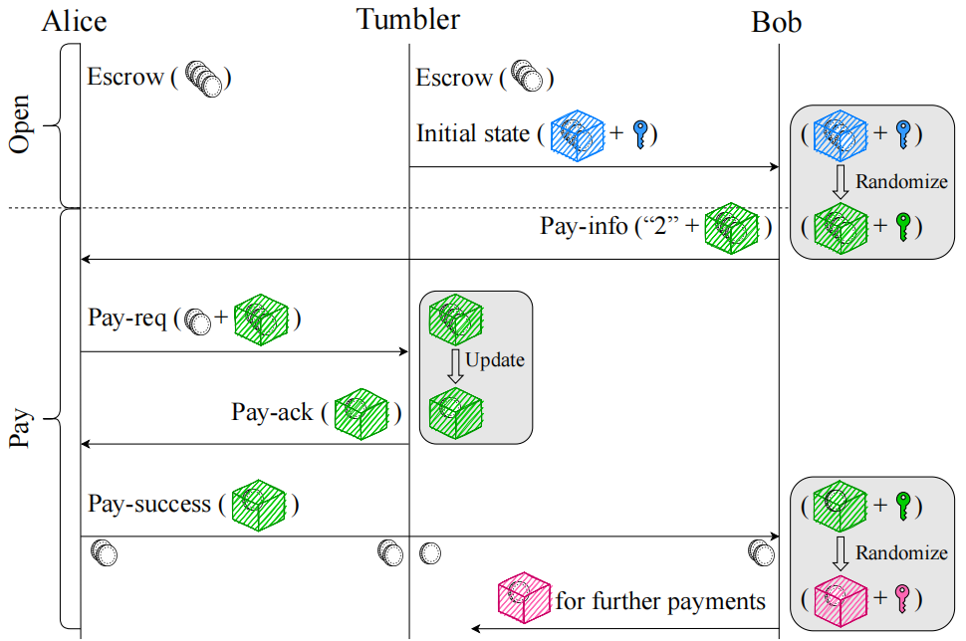
Applying RSUC to Accio

Slide 16
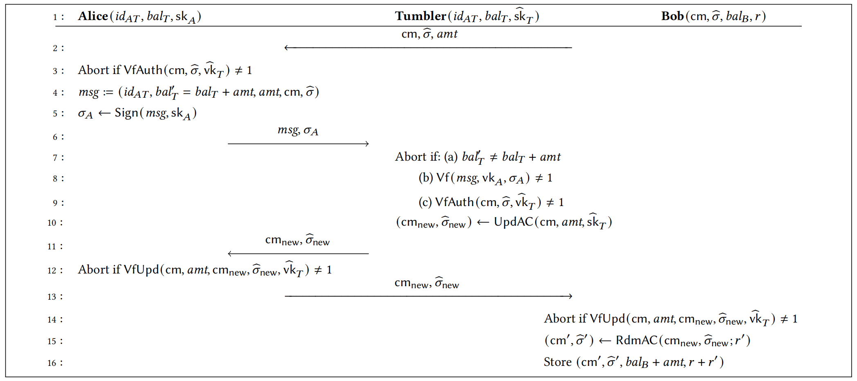
Applying RSUC to Accio

Slide 17
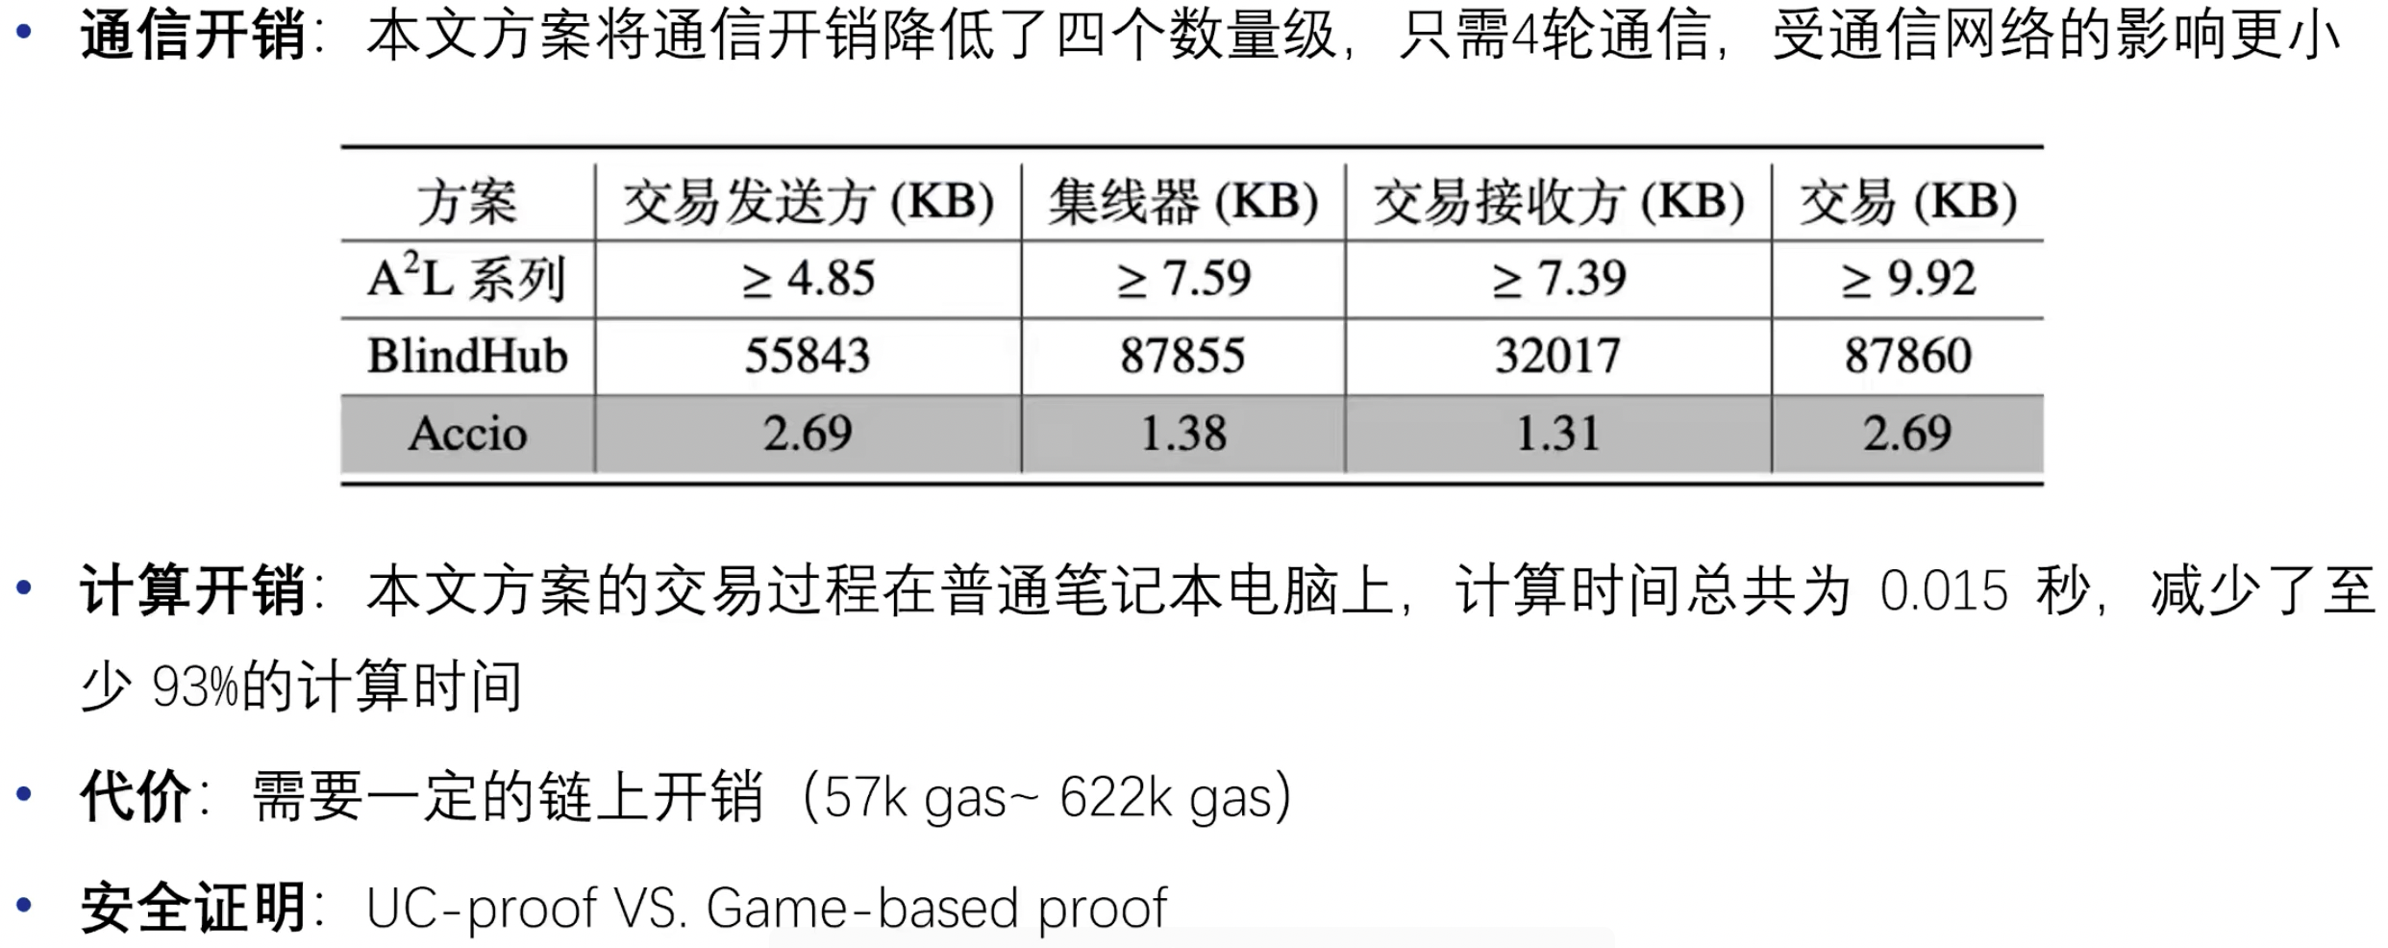
Off-chain Cost Evaluation

Slide 18
Thanks!

